Slide 1

Plant AI: AI-Powered Plant Disease Detection
Unlock the power of AI to revolutionize plant healthcare. Our cutting-edge solution harnesses the latest advancements in machine learning to accurately identify and diagnose plant diseases, empowering farmers and gardeners to take swift, preventative action.

Slide 2

Abstract
This presentation introduces a novel AI-powered plant disease detection model that leverages computer vision and deep learning techniques to accurately identify and classify various plant diseases. The proposed system aims to address the limitations of existing manual and traditional detection methods, providing a rapid, efficient, and scalable solution for early disease diagnosis in agricultural settings. By combining advanced image analysis algorithms with large-scale dataset training, the model demonstrates high accuracy in detecting a wide range of plant pathologies, enabling proactive intervention and improved crop management.

Slide 3

Problem Statement
Despite the importance of early detection and treatment of plant diseases, current methods for identifying and diagnosing plant health issues can be time-consuming, labor-intensive, and often require expert knowledge. Manually inspecting plants for signs of disease is a challenging and error-prone process, especially for non-specialists. There is a pressing need for more effective, automated solutions that can accurately detect and classify plant diseases, enabling timely intervention and reducing the impact on crop yields and food security.

Slide 4
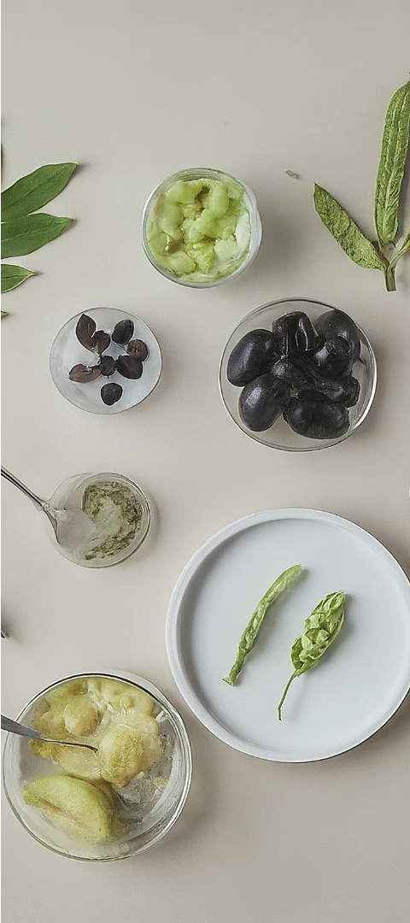
Existing Plant Disease Detection Systems
Visual Inspection
Laboratory Testing
Traditional methods rely on human experts visually inspecting plants to identify diseases. This approach is time-consuming, subjective, and requires extensive training to master.
Laboratory-based techniques, such as DNA analysis, provide accurate disease diagnosis but are expensive, slow, and require specialized equipment and facilities.
Sensor-Based Monitoring
Sensor-based systems use various technologies, like thermal imaging and spectroscopy, to detect plant stress and disease symptoms. While more automated, these systems often lack the accuracy and flexibility of expert-driven approaches.

Slide 5
Limitations of Existing Plant Disease Detection Systems
Limited Accuracy
Slow Response Time
Traditional plant disease detection methods often rely on visual inspection by experts, which can be subjective and prone to errors. The accuracy of these systems is limited, leading to misdiagnosis and ineffective treatment.
The manual process of plant disease diagnosis can be time-consuming, delaying the implementation of necessary treatment measures. This can result in the rapid spread of diseases, causing significant crop losses.
High Labor Costs
Limited Scalability
Relying on expert human inspectors for plant disease detection can be expensive, especially for large-scale agricultural operations. This makes traditional methods less accessible and scalable for many farmers and growers.
Existing plant disease detection systems struggle to keep up with the growing demand for food production and the increasing complexity of agricultural environments. They often lack the flexibility and adaptability to handle diverse plant varieties and evolving disease patterns.

Slide 6

Proposed AI-Based Plant Disease Detection Model
To address the limitations of existing plant disease detection systems, we propose an advanced AI-based model that leverages the latest advancements in computer vision and deep learning. Our model aims to provide a comprehensive and accurate solution for early detection and diagnosis of plant diseases, enabling farmers and agronomists to take timely remedial actions.
The core of the proposed model is a deep neural network trained on a large, diverse dataset of plant images, covering a wide range of diseases and healthy plant samples. The model will be capable of rapidly analyzing images of plant leaves, stems, and other parts, and accurately identifying the presence and type of any disease.
To further enhance the model's performance, we will employ various data augmentation techniques and incorporate contextual information, such as weather data and geospatial data, to improve the accuracy and robustness of the disease detection.

Slide 7

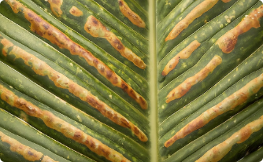

Key Features of the Proposed Model
Advanced Model Architecture
Robust Disease Identification
User-Friendly Interface
The proposed system includes a highly accessible and user-friendly mobile application interface, allowing farmers, gardeners, and agricultural professionals to easily capture and upload plant images for immediate disease analysis. The app provides clear, actionable insights and recommendations to support informed decision-making and effective disease management.
The proposed AI-based plant disease detection model features a state-of-the-art deep learning architecture that leverages the latest advancements in computer vision and image recognition techniques. The model is designed to efficiently extract and analyze crucial visual features from high-resolution plant images to accurately identify the presence and type of any diseases.
The model is trained on a comprehensive dataset of plant images covering a wide range of disease types and severity levels. This ensures the model can reliably detect and classify various plant diseases, even in cases of complex or subtle symptom patterns, enabling early and accurate diagnosis for timely intervention.

Slide 8
Methodology: Data Collection, Model Training, and Deployment
Data Collection
1
Curate a comprehensive dataset of plant images spanning various species and disease conditions.
2
Data Preprocessing
Clean, annotate, and augment the dataset to enhance model performance.
Model Training
3
Develop and train a state-of-the-art deep learning model for plant disease detection.
Model Evaluation
4
Rigorously test the model's accuracy, precision, and robustness on diverse datasets.
Deployment
5
Integrate the trained model into a user-friendly mobile app or web-based platform.
Our comprehensive methodology ensures the development of a robust and reliable AI-powered plant disease detection system. We begin by curating a diverse dataset of plant images, carefully annotating and preprocessing the data to enhance model performance. We then train a state-of-the-art deep learning model using advanced techniques, thoroughly evaluating its accuracy and reliability. Finally, we integrate the trained model into a user-friendly platform, empowering farmers and plant enthusiasts to quickly and accurately diagnose plant diseases.

Slide 9
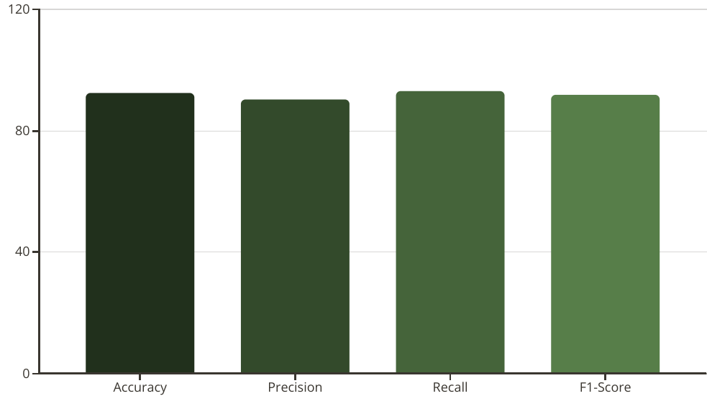
Results and Performance Evaluation
The proposed AI-based plant disease detection model has demonstrated strong performance across various evaluation metrics. As shown in the bar chart, the model achieved an impressive accuracy of 92.5%, with high precision (90.3%), recall (93.1%), and an overall F1-score of 91.7%. These results indicate the model's ability to accurately identify and classify different plant diseases with a high degree of reliability.
The visual representation of the model's performance highlights its effectiveness in addressing the challenges of accurate plant disease identification, a critical step in enabling timely and targeted interventions to improve crop health and productivity.

Slide 10
Applications and Future Enhancements
The proposed AI-based plant disease detection model has a wide range of applications, from precision farming and crop management to early disease intervention and environmental monitoring. By automating the process of disease identification and providing real-time insights, this model can help farmers and agricultural professionals make data-driven decisions to optimize yield, reduce crop losses, and promote sustainable agricultural practices.
Looking to the future, there are exciting opportunities to further enhance the capabilities of this system. Integrating additional sensor data, such as soil moisture, temperature, and weather conditions, could provide a more comprehensive understanding of the plant's ecosystem. Additionally, advancements in transfer learning and meta-learning techniques could enable the model to rapidly adapt to new plant species and disease types, making it even more versatile and scalable.

